Slide 1


PROPRIETARY AND CONFIDENTIAL
REIMBURSEMENT
MODELING & DECISION
SUPPORT
DATA DRIVEN; AI ENABLED REIMBURSEMENT & PAYMENT OPTIMIZATION

Slide 2


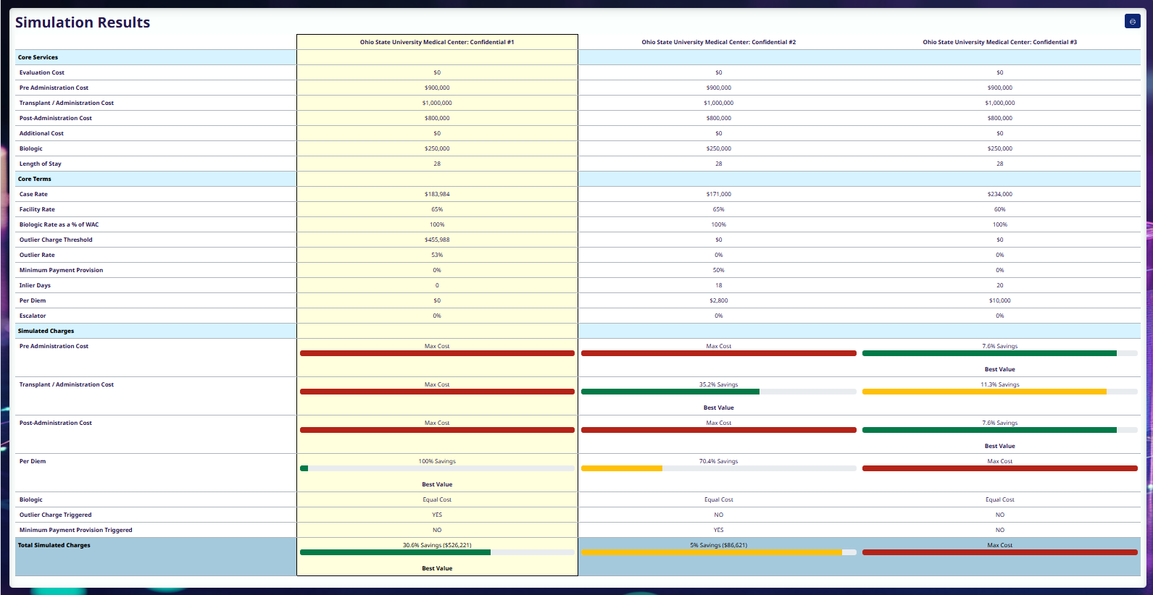
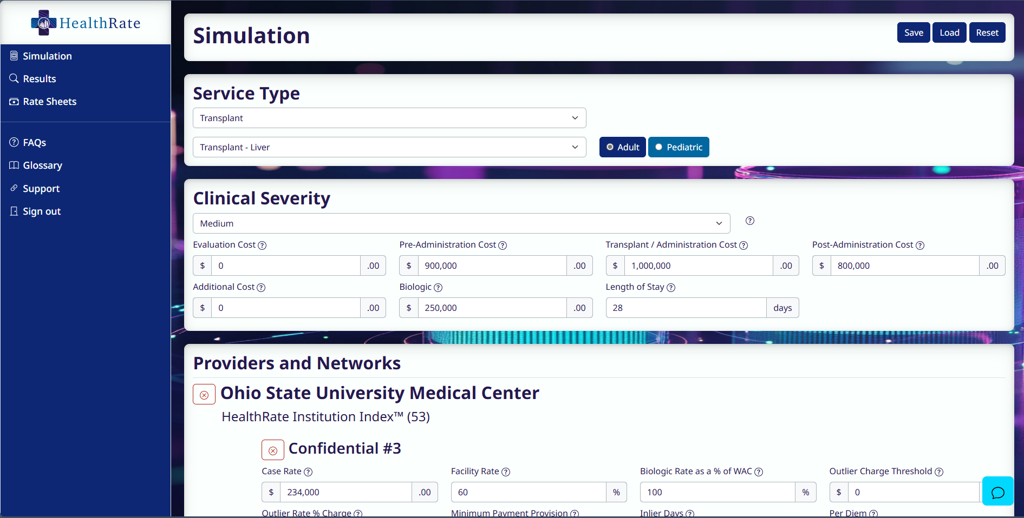
PROPRIETARY AND CONFIDENTIAL
SaaS PLATFORM OVERVIEW
01
What is HealthRate
Platform
An Award-Winning* SaaS platform that provides the best pricing for high-cost claims
No impact to quality
No provider abrasion
No patient intervention required
No claims auditing or cash recovery
The “GoodRx for catastrophic claims”
* HIMSS 2025 Best In Show Payer Analytics, HealthcareMN 2024 Start Up of the Year Nominee

Slide 3

PROPRIETARY AND CONFIDENTIAL
HEALTHRATE EXPERTISE
02
How it Works
PAYMENT OPTIMIZATION &
DECISION SUPPORT
Sign contract
Onboard (2 weeks on average)
Training included
Secure solo tenant established
Contracts loaded
Run HealthRate check
Save money!
Built on decades of domain experience, trillions of data points, advanced statistical methods, and recent advancements in AI/ML
HealthRate proactively identifies the optimal source and cost of care.

Slide 4
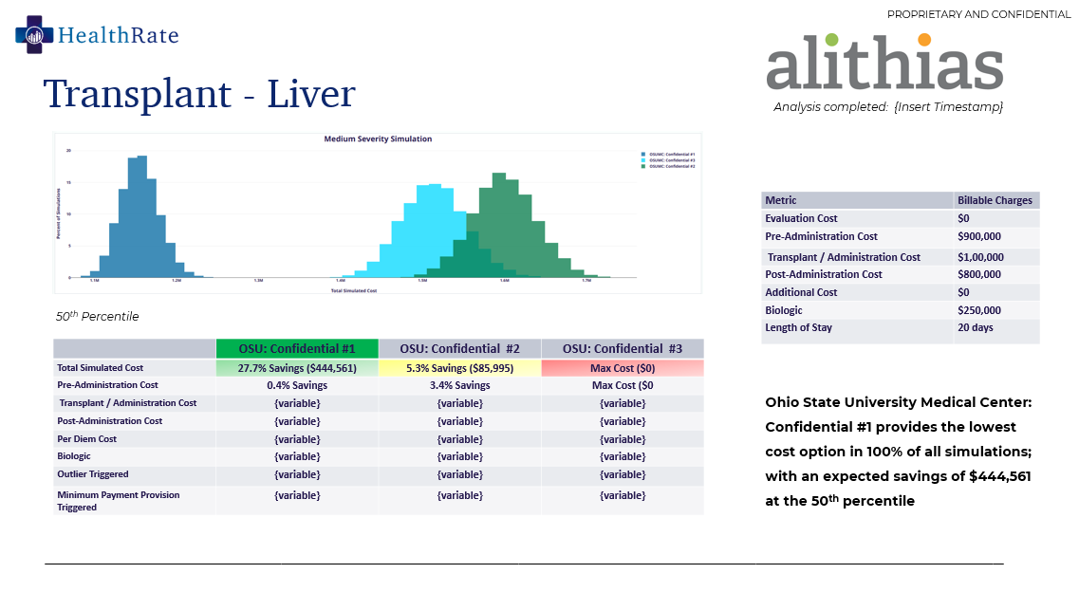




PROPRIETARY AND CONFIDENTIAL
HEALTHRATE SOLUTION
03
What Do I Get?
RETURN ON INVESTMENT
.
Prevents dollars from ever going out the door driving immediate bottom-line impact in the millions
UNBIASED
We maintain complete independence and objectivity and do not accept external compensation
FIDUCIARY
.
A detailed cost analysis is completed and available for your review for each and EVERY case resulting in $50,000 - $1,000,000+ in savings per case
UNPRECEDENTED
.
We are NOT a transparency data provider and we are NOT a patient navigation or COE solution
REAL-TIME
.
HealthRate is always current with your data, available 24x7 and responds within seconds

Slide 5

PROPRIETARY AND CONFIDENTIAL
IMPLEMENTATION & PRICING
04
Implementation Process
IMMEDIATE BENEFITS INCLUDE:
Minimal training
Zero-technology integration
Contains no HIPAA data
Uses your existing processes and workflow
Lower billed and allowed claims
Self-service or a full-service model eliminating the need for any staffing on your part
Seamless integration with existing systems
End-to-end encryption and secure individual tenant

Slide 6
CASE STUDY
PROPRIETARY AND CONFIDENTIAL
[Major US Health System] – Multiple Organ
05
COST ANALYSIS & RECOMMENDATION
Transplant Allowed Variances
 |  | [Client]
MS-DRG Description | MS-DRG | Low | High | Opportunity
HEART AND LUNG TRANSPLANT | MULTIPLE | $1,029,875.72 | $3,243,820.81 | $2,213,945.09
Estimated charges at [client] across eight established networks were evaluated to determine the range of opportunity

Slide 7
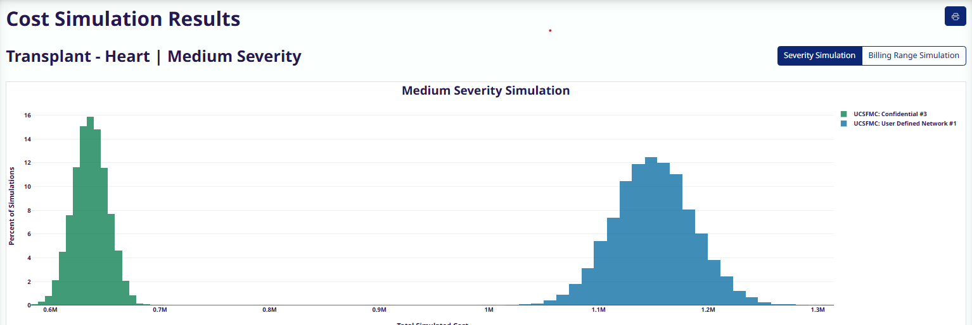
CASE STUDY
PROPRIETARY AND CONFIDENTIAL
Transplant – Heart + Lung
06
[Client Confidential]
Analysis completed: Friday, March 7, 2025
Metric | Billable Charges
Evaluation Cost | $0
Pre-Administration Cost | $400,000
Transplant / Administration Cost | $1,20,000
Post-Administration Cost | $700,000
Additional Cost | $0
Biologic | NA
Length of Stay | 60 days
50th Percentile
 | MC: Confidential #1 | MC: Confidential #2
Total Simulated Cost | 44.6% Savings ($512,941) | Max Cost ($0)
Pre-Administration Cost | Max Cost ($0) | 1.3% Savings
Transplant / Administration Cost | Max Cost ($0) | 37.5% Savings
Post-Administration Cost | Max Cost ($0) | 11.2% Savings
Per Diem Cost | N/A | N/A
Biologic | EQUAL | EQUAL
Outlier Triggered | YES | NO
Minimum Payment Provision Triggered | NO | YES
Confidential #1 provides the lowest cost option in 100% of all simulations; with an expected savings of $512,941 at the 50th percentile
What “looks good” is rarely the best option.

Slide 8


PROPRIETARY AND CONFIDENTIAL
Thank you
FOR YOUR TIME
JEFF SAGE
Chief Technology Officer
JEFF@HEALTHRATE.IO
303-877-9067

Slide 9
PROPRIETARY AND CONFIDENTIAL
HEALTHRATE EXPERTISE
How it Works
Specialty Contracting Expertise + Legislative Changes
Niche industry experts who have defined the industries payment methodologies, levers, and triggers for specialty reimbursement
Transparency in Coverage and No Surprises Act have triggered increased competition
PAYMENT OPTIMIZATION &
DECISION SUPPORT
Advanced Actuarial Expertise
Built on decades of domain experience, trillions of data points, advanced statistical methods, and recent advancements in AI/ML, HealthRate proactively identifies the optimal source and cost of care.
Decades of real-world data
Proprietary Artificial Intelligence(AI) to ingest and process payment terms
Advance statistical analysis and proprietary algorithms to identify and quantify opportunities
De-Mystified
Update your precertification and utilization processes with existing staff or have HealthRate do it for you
Instantly evaluate all available provider rates
Login to www.healthrate.io and begin saving!

